Slide 1
Customer Churn & Retention Analysis End-to-End Data Analytics Using Python, SQL & Power BI
Name: Majji Prasanth Reddy Tools used: Python, MySQL, Power BI

Slide 2
Problem Statement
The business is experiencing inconsistent revenue due to declining customer retention and limited visibility into which customers are likely to churn. Without a structured understanding of purchasing behavior, customer value, and early-warning indicators, the organization cannot effectively prioritize retention efforts or allocate marketing resources. This project aims to analyze customer transactions, segment customers based on behavioral patterns, predict churn risk using machine learning, and provide data-driven strategies to improve customer loyalty and protect revenue.

Slide 3
Dataset Overview
Source: Online Retail Dataset (Kaggle) Tables Used: E-Commerce Data(~500K rows) Key Fields: InvoiceNo, StockCode, Description, Quantity, InvoiceDate, UnitPrice, CustomerID, Country Tools Used: Python, SQL and Power BI

Slide 4
Project Workflow
Data Extraction → Data Cleaning → SQL Analytics → RFM Segmentation → Cohorts → ML Model → Dashboard → Insights & Actions

Slide 5
Data Cleaning & Processing
Removed null Customer IDs
Removed negative quantity rows
Created Total Amount column
Built Customer Summary Table (orders, revenue, recency, frequency, monetary)

Slide 6
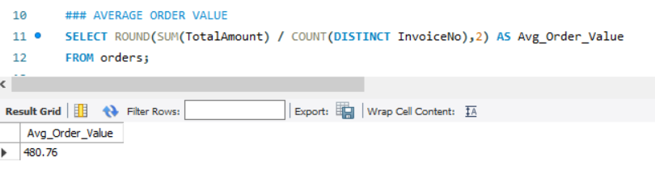
Data Analysis using SQL
What is the average order value across all transactions?

Slide 7
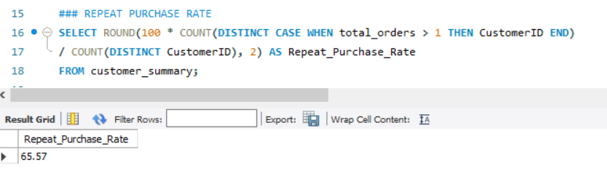
Data Analysis using SQL
What percentage of customers purchase more than once?

Slide 8
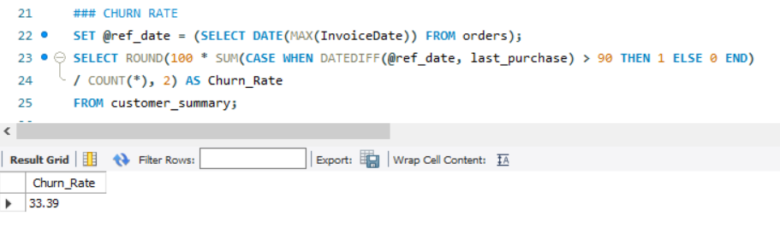
Data Analysis using SQL
What percentage of customers are churned (inactive for > 90 days)?

Slide 9
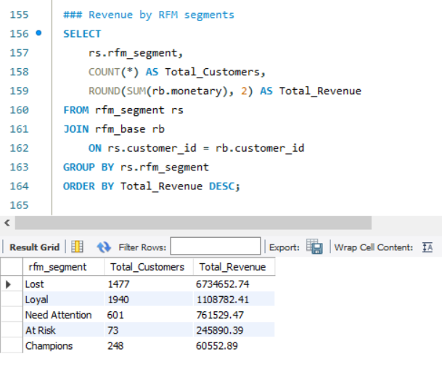
RFM Segmentation
Revenue Generated by RFM Segments

Slide 10
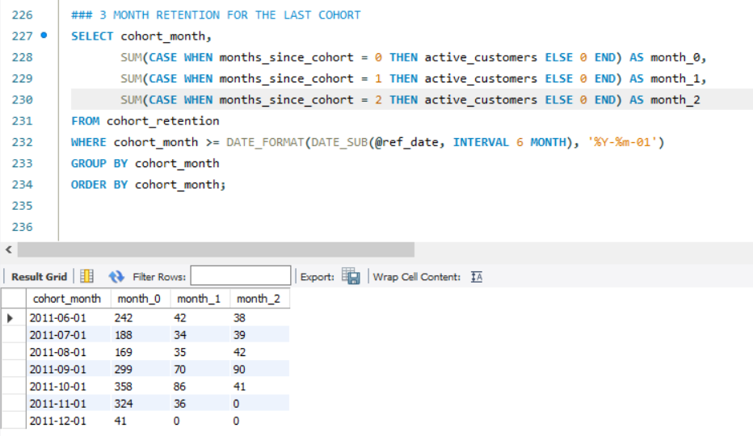
Cohort Analysis
How does recent cohort retention (0–2 months) compare with older cohorts?

Slide 11
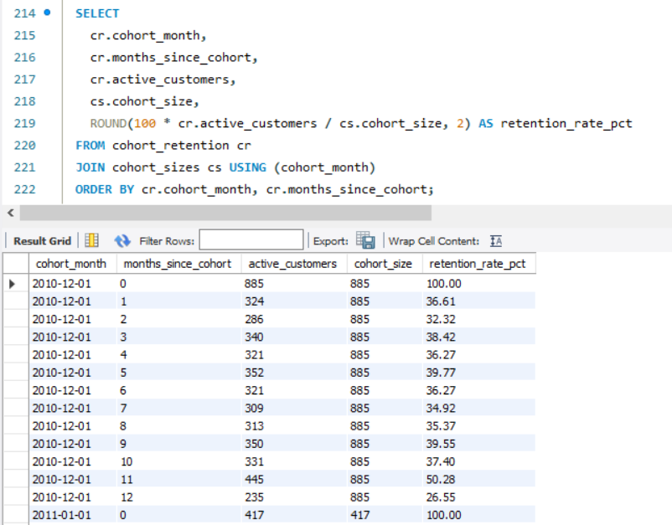
Cohort Analysis
What is the month-over-month retention rate for each customer cohort?

Slide 12
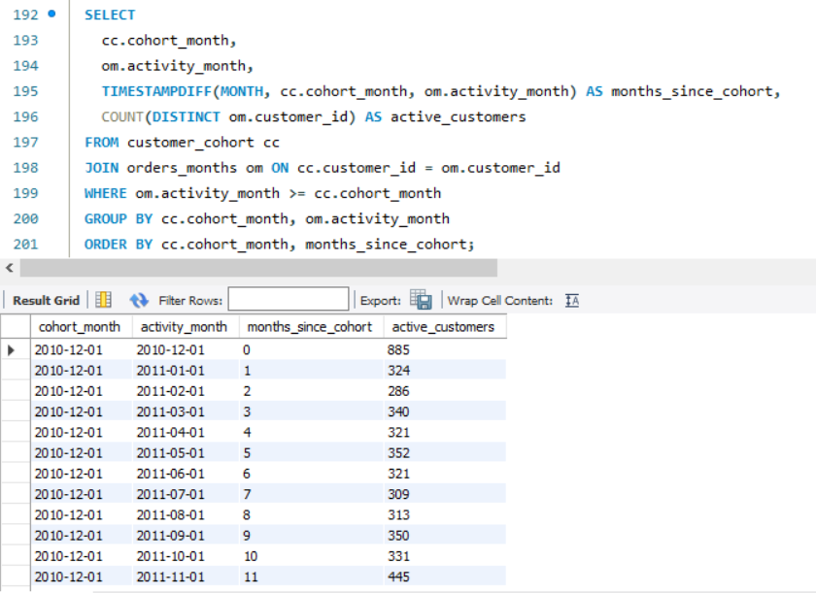
Cohort Analysis
How many customers remain active in each cohort month over time?

Slide 13
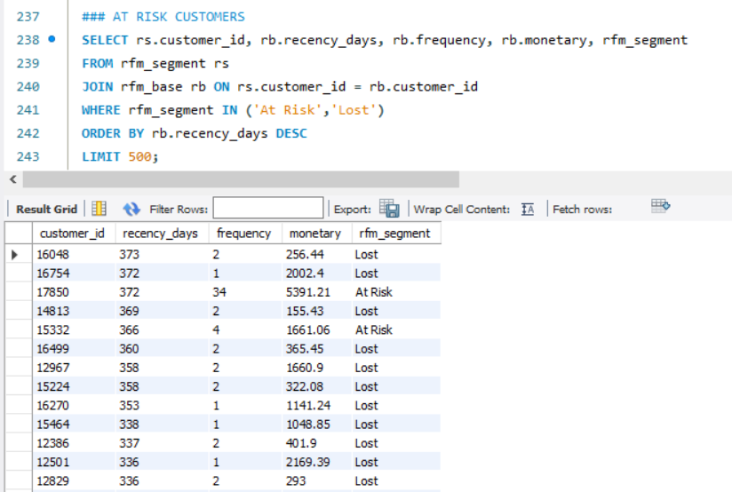
At-Risk & Lost Customers
Using the RFM segmentation output, customers labelled ‘At Risk’ and ‘Lost’ were extracted

Slide 14
Machine Learning Model
Algorithm: Random Forest
Features: Recency, Frequency, Monetary
Accuracy: 0.97
AUC: 0.996
Top Churn Driver: Frequency

Slide 15
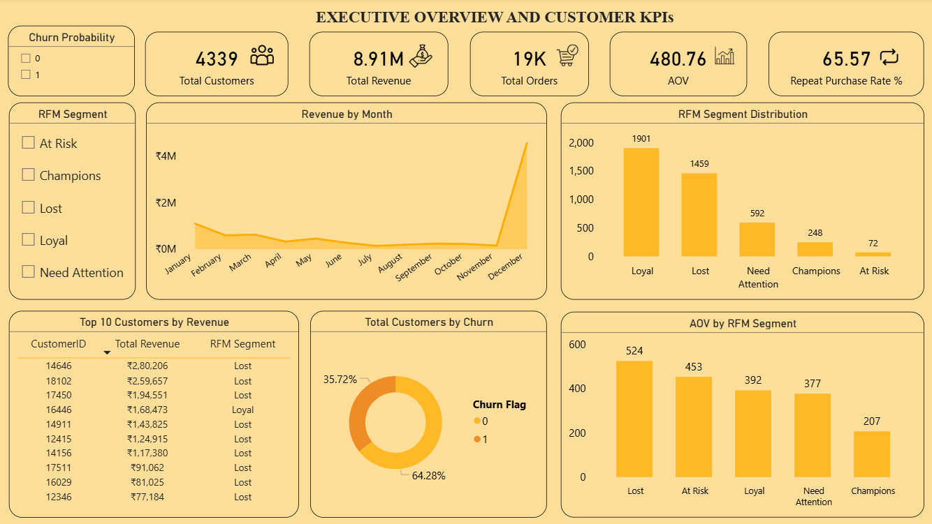
Power BI Dashboard
Customer & Revenue Overview

Slide 16
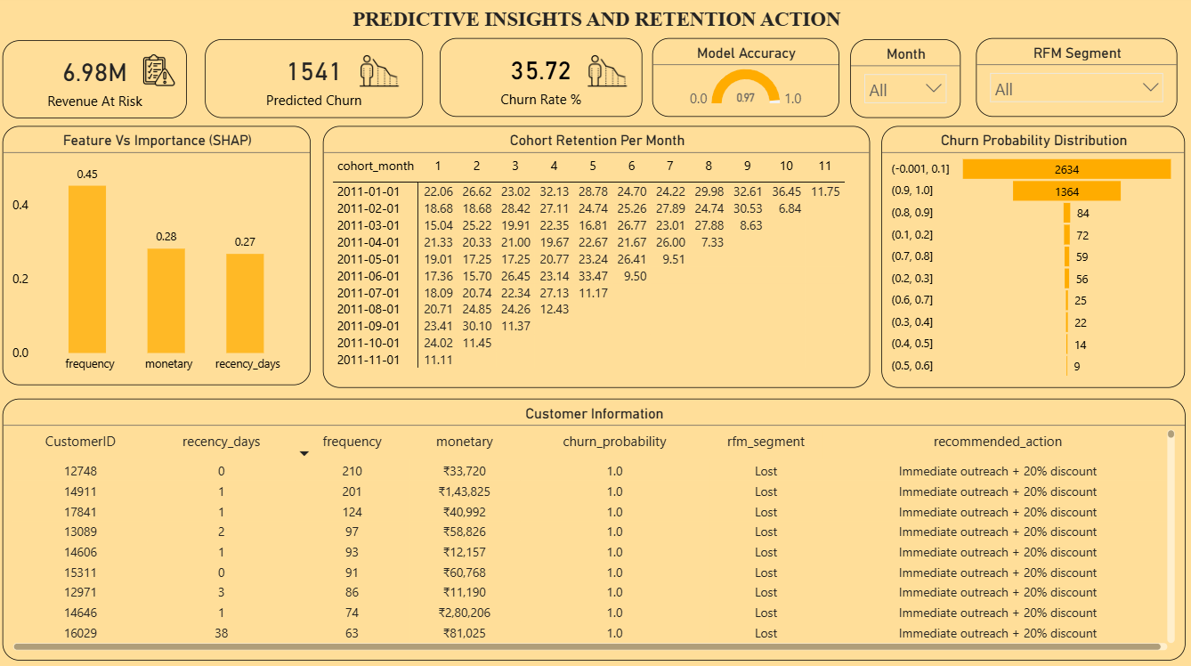
Power BI Dashboard
Predictive Insights & Retention Action

Slide 17
Business Insights & Findings
Loyal customers drive the business
Revenue is heavily dependent on “Lost” customers
Churn risk is high (35.7%)
Frequency is the strongest driver of churn
Revenue at risk is extremely high (₹6.98M)
Cohort retention drops sharply after Month 1
Late-year revenue spikes (December)

Slide 18
Business Recommendations
Recover Lost Revenue — target win-back campaigns
Improve Early Retention — strengthen first-month engagement
Boost Purchase Frequency — offer purchase-linked rewards
Strengthen Loyalty Base — exclusive perks for Loyal segment
Upsell Active Customers — promote bundles & premium products

Slide 19


